Slide 1



Gas Station Dr . Ayman Abdeltawab
1- Mahmoud khalaf allah mohamed elsayd

Slide 2
Introduction
Our app provides gas station products and other services
Our problem is not being able to go Gas station we don’t have time to go.
The goal here is facilitate the process of reach the nearest petrol station

Slide 3
Objective
To let Users reach to gas station products and services from nearest gas station available
The goal here is saving the time and effort

Slide 4
Project Idea
The project is divided into two applications
1- Application for customers - customers can searches for products or any service
2–Admin system - It is a web designed application , admin can control all the data

Slide 5



Tools and Programming languages used
1- Android studio : The main software for our project
2- Smarter ASP.NET : this website https://www.smarterasp.net/ will be the app server we use MSSQL database in admin and customer app
3- Firebase : this website https://firebase.google.com/ will be using to store images , files , video because it’s not allowed in MSSQL because large size of media files we have limited bandwidth in MSSQL

Slide 6

Tools and Programming languages used
4- Java Programming Language : Using to programming all application
5- SQL (Structured Query Language) : We use this language to get , send , edit and delete data from database
6- XML (Extensible Markup Language ) : we used this language to make the design in android studio

Slide 7


Tools and Programming languages used
This section will be design web application to admin all
data in mobile application admin can be add , delete ,
update , search data
This section will be using tools and software and programming language ,
as the following :
Microsoft Visual studio 2013 : this software using to design all web pages
And connect this pages with database SQL server
Microsoft SQL Server Management Studio : this program will be using for design Database and design a table column , relationships for our project
C# : programming language To coding all web page , and using
ASP.Net to connection between Database and web page

Slide 8
For Customers Application :
The customer will enter his/her information (user name, password, and email, phone number) to create his account.
Register.
Login
Choose Gas Station from map
Choose Gas Station from home page
Choose desired product
Make an order
Rating it

Slide 9
For Admin Application :
Manage and supervise the overall transactions of the application.
Add any updated information.
Access to database to see any needed information.

Slide 10
Analysis
ERD ( Entity Relationship Diagram )
RS ( Relational Schema )

Slide 11
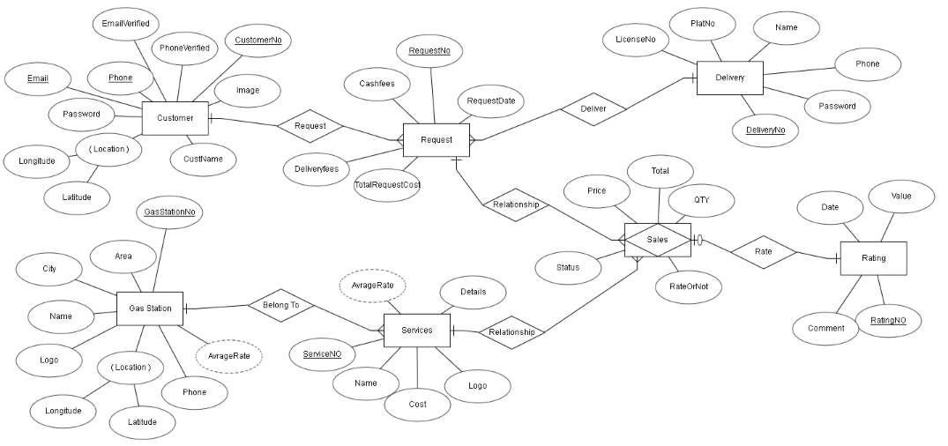
Entity Relationship Diagram

Slide 12
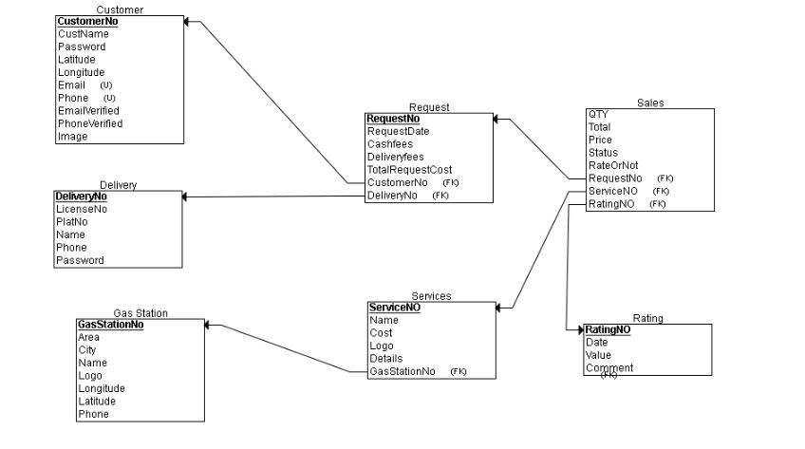
Relational Schema

Slide 13
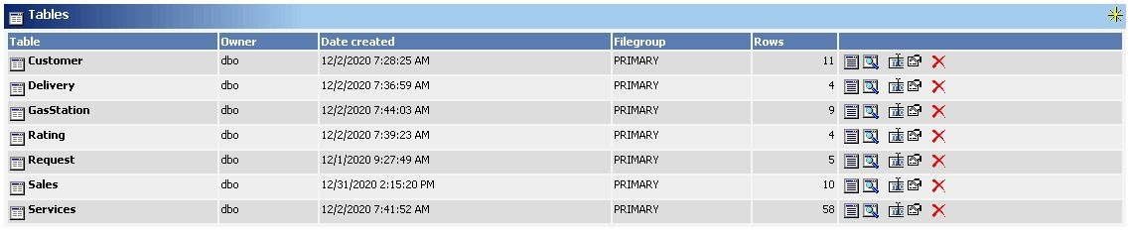
Database Tables

Slide 14
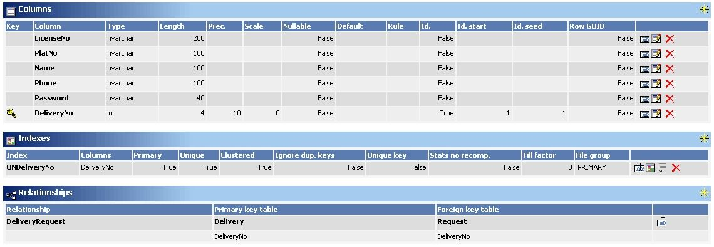
Delivery Table

Slide 15
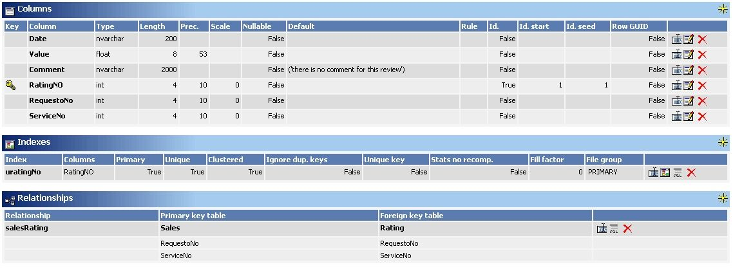
Rating Table

Slide 16
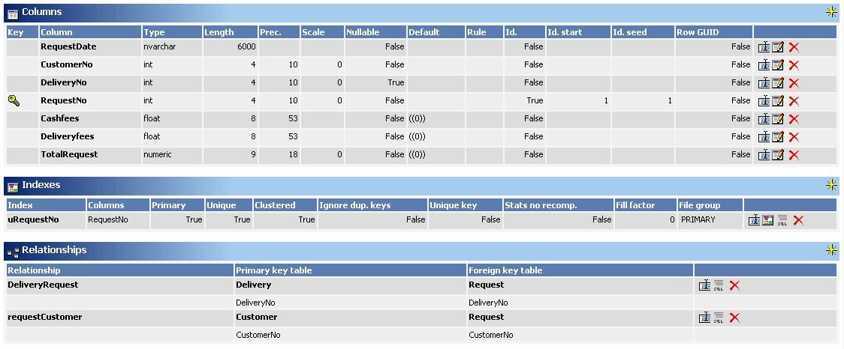
Request Table

Slide 17
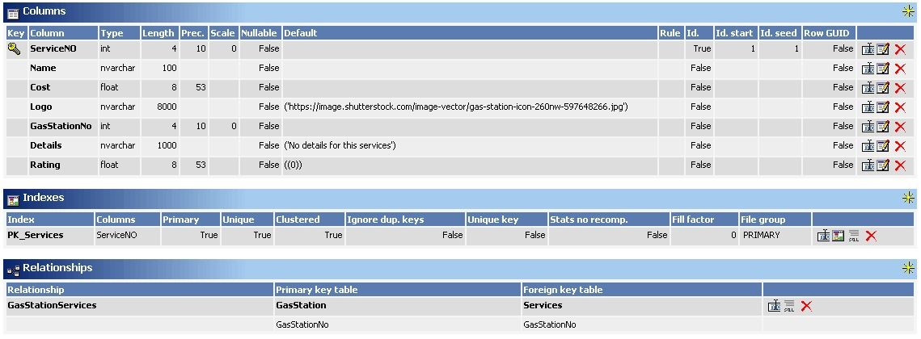
Services Table

Slide 18
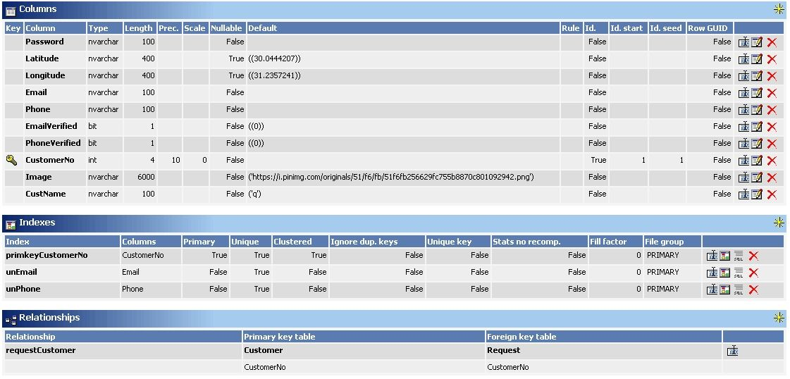
Customers Table

Slide 19
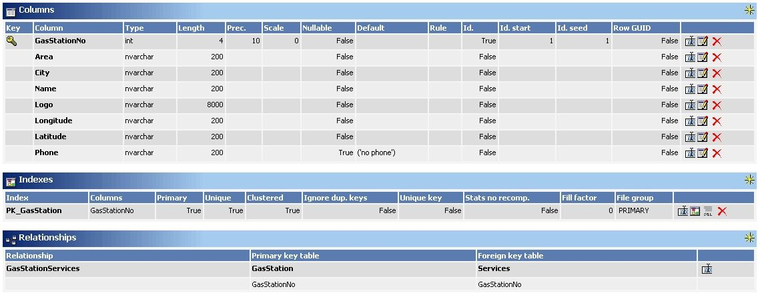
Gas Stations Table

Slide 20
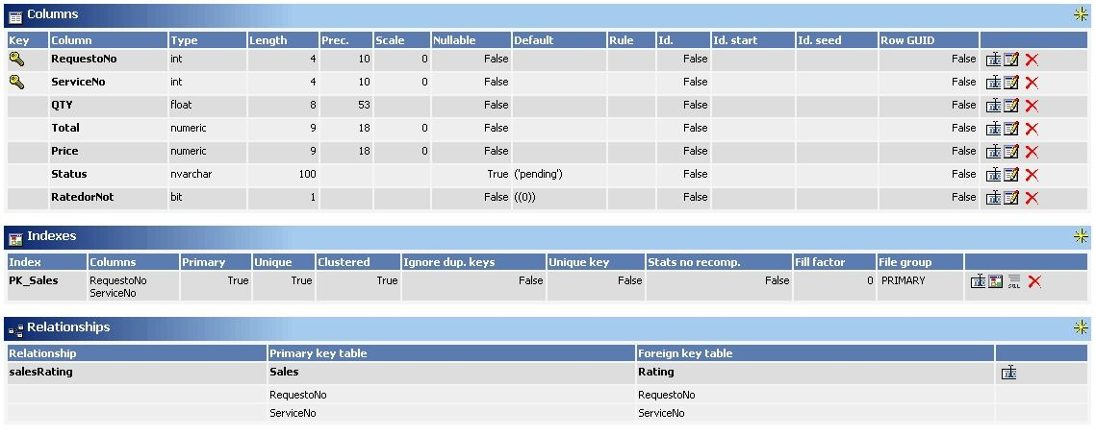
Sales Table

Slide 21
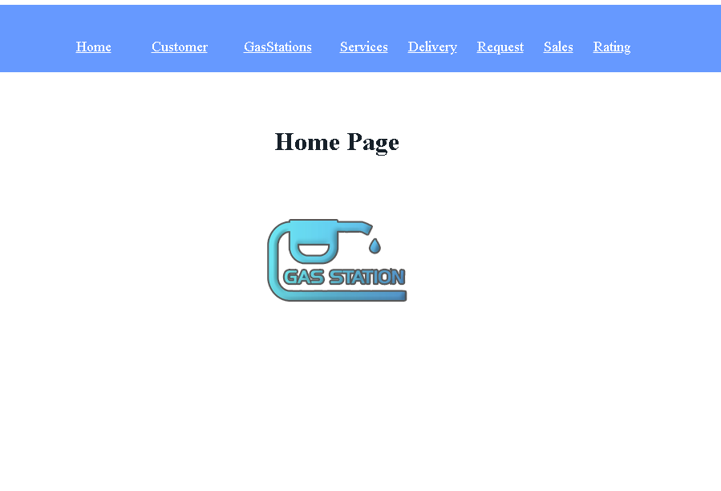
Admin App : Home page

Slide 22
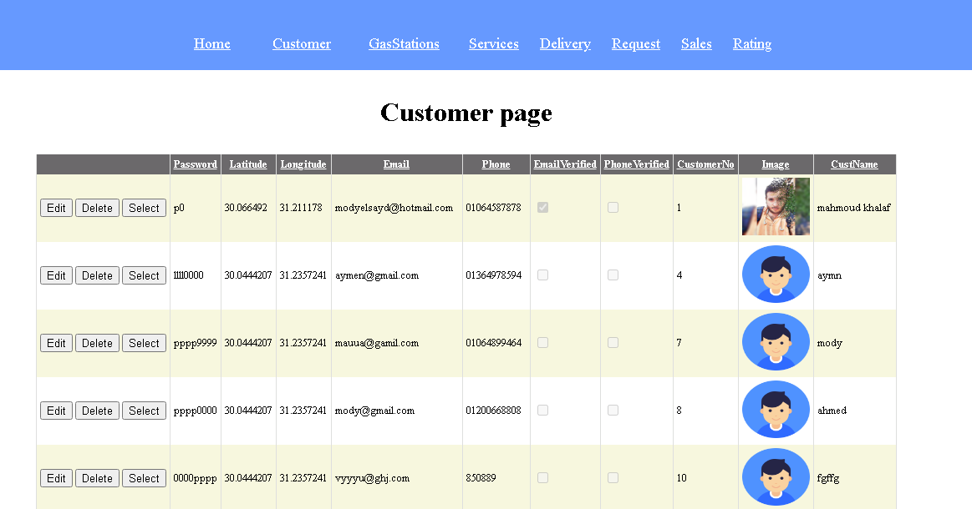
Customer page

Slide 23
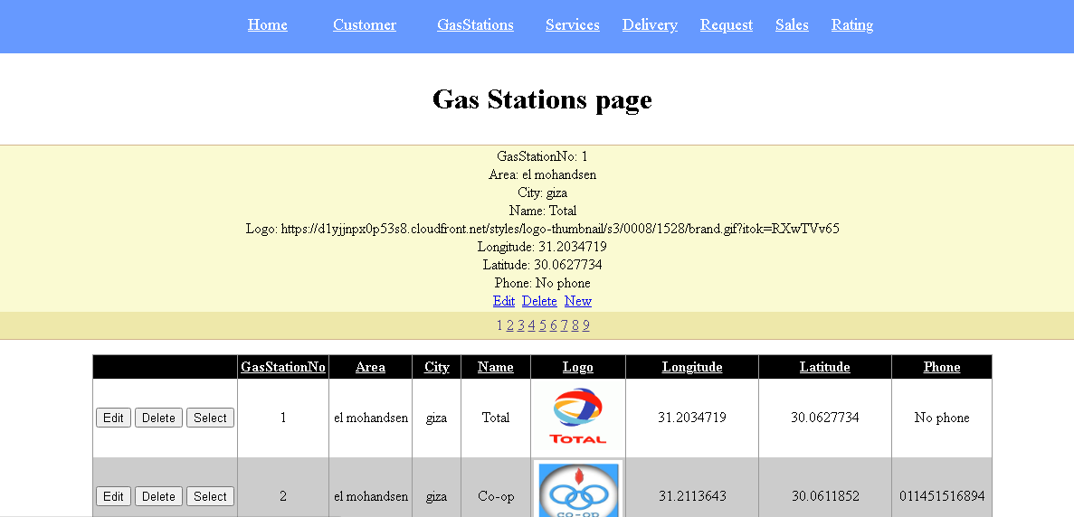
Gas Stations page

Slide 24
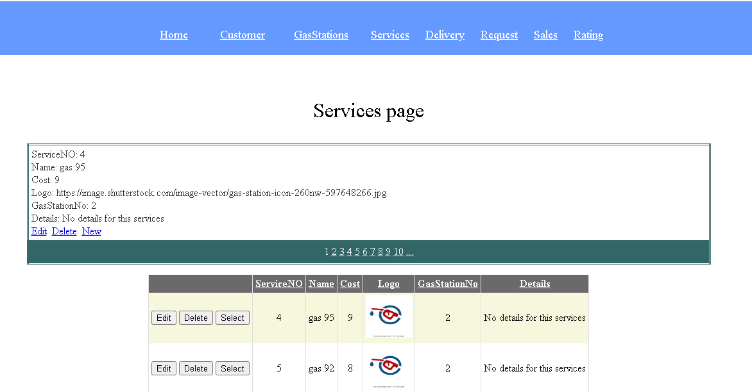
Services page

Slide 25
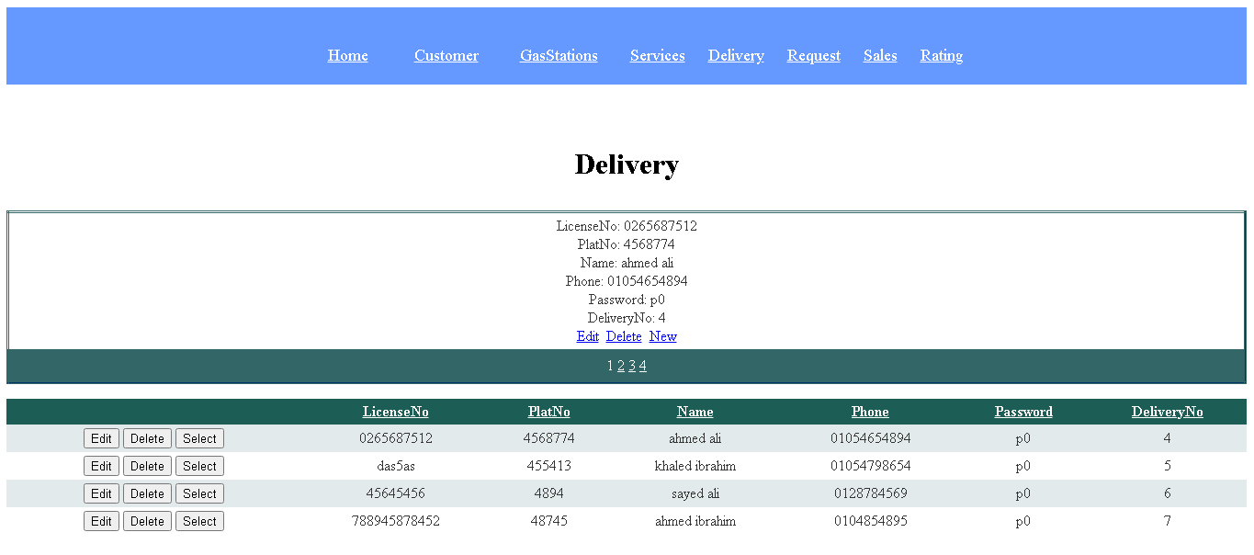
Delivery page

Slide 26
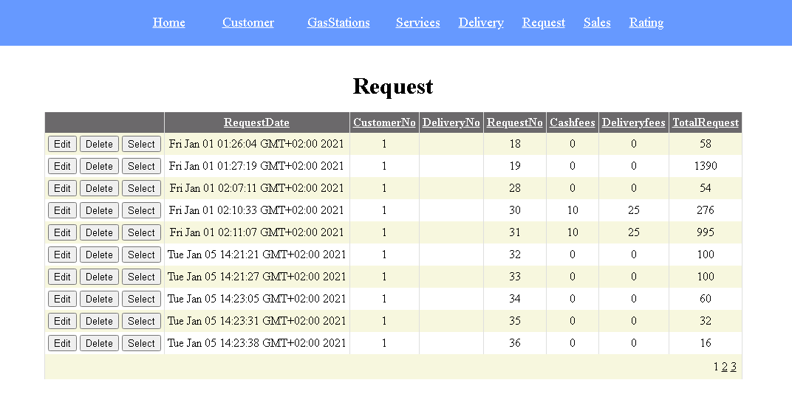
Request page

Slide 27
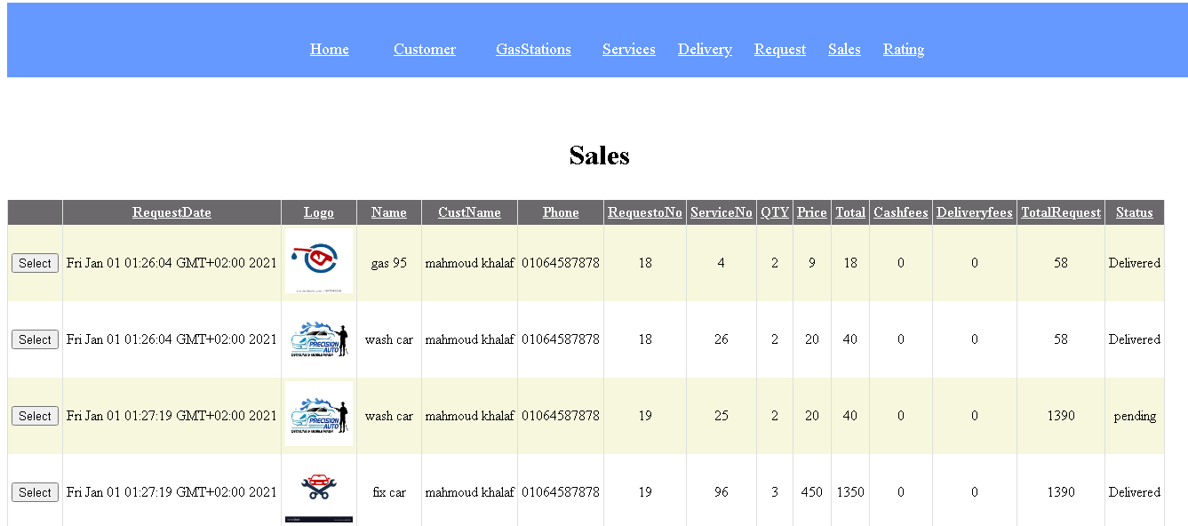
Sales page

Slide 28
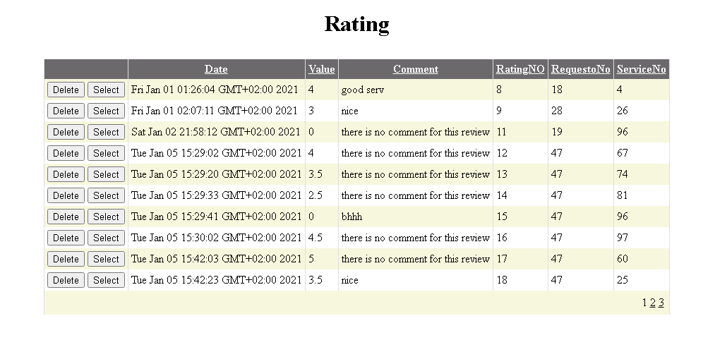
Rating page

Slide 29
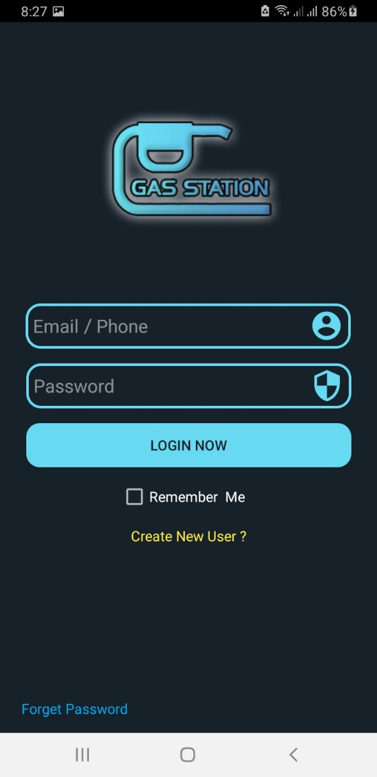
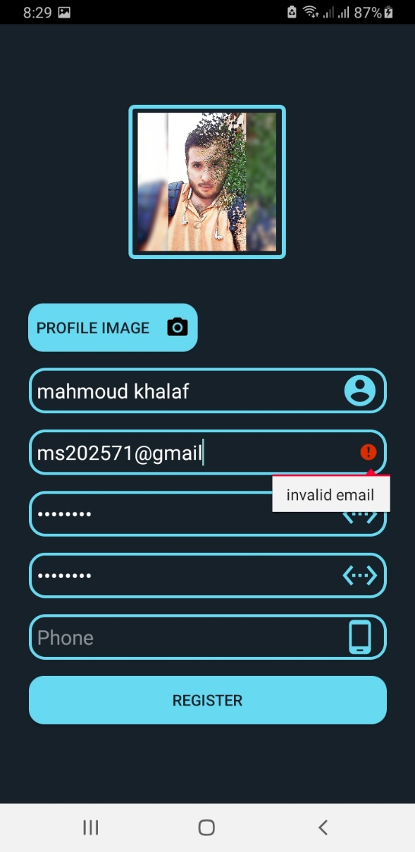
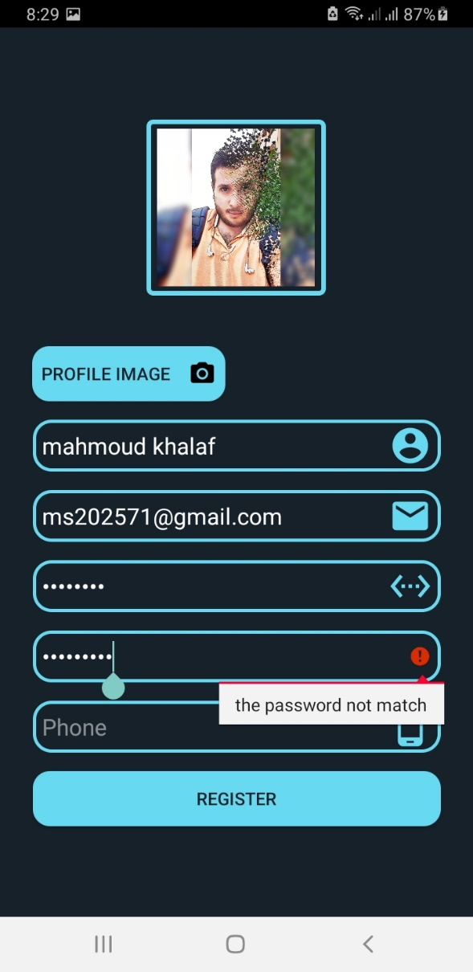
Screen shot

Slide 30
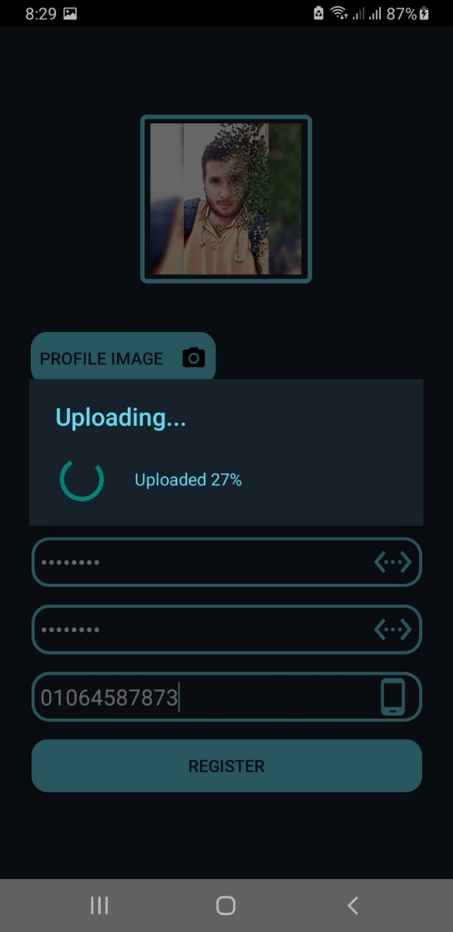
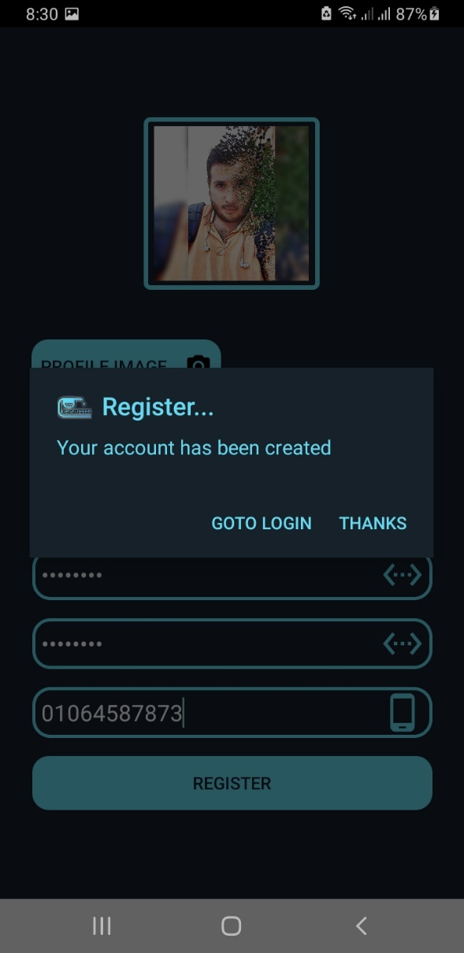
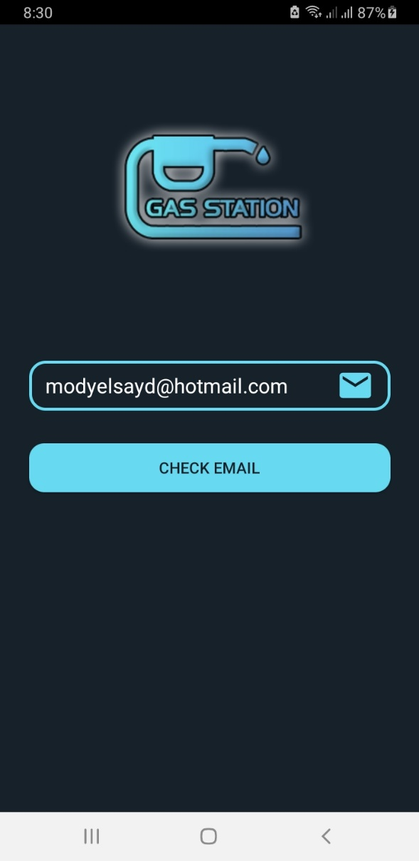
Sign up Screen and Forget Password

Slide 31
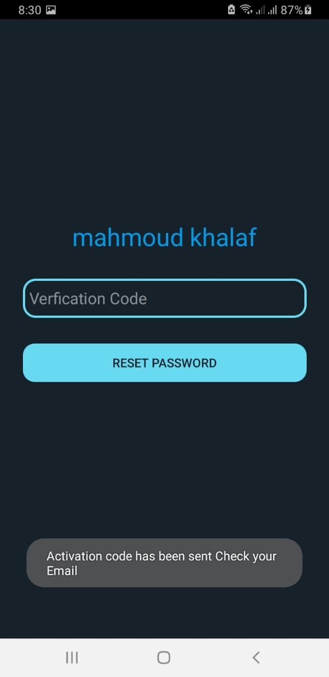
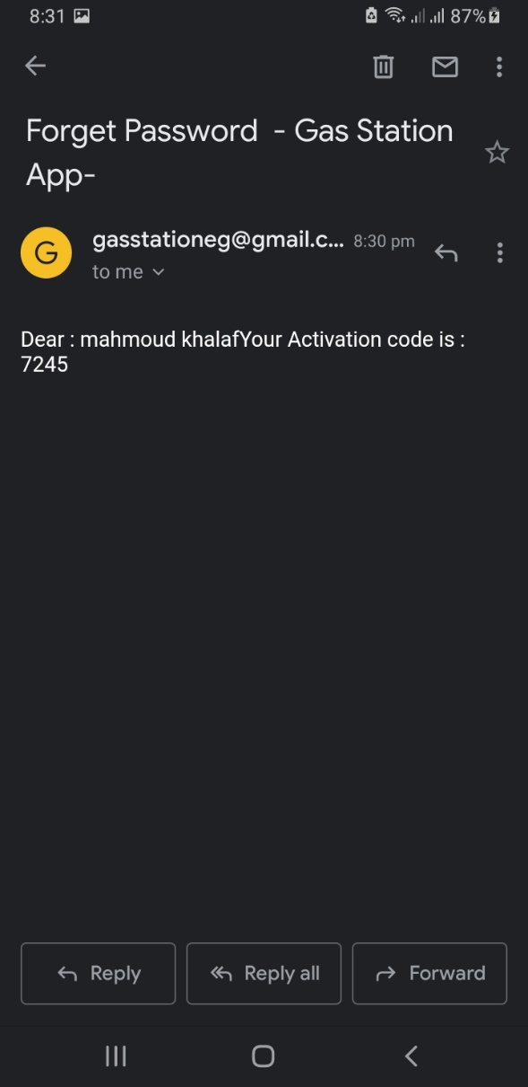
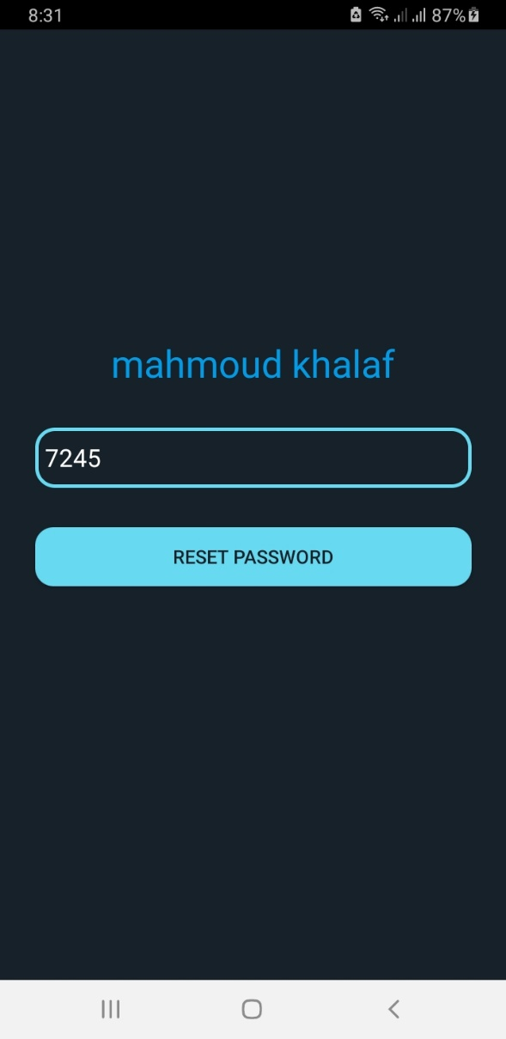
Getting Verification Code from Email

Slide 32
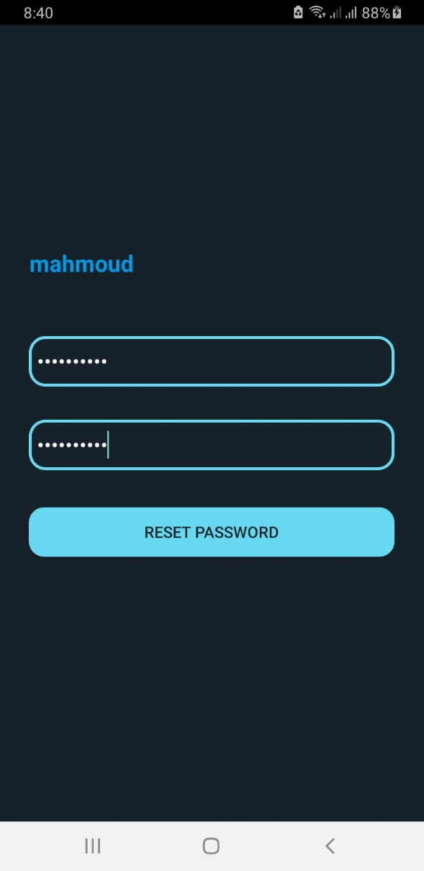
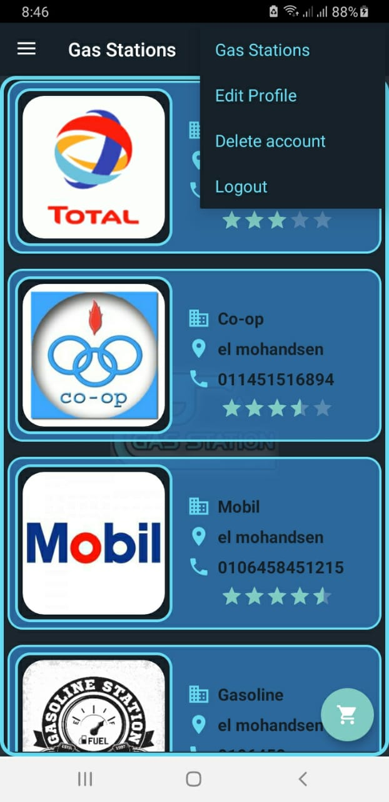
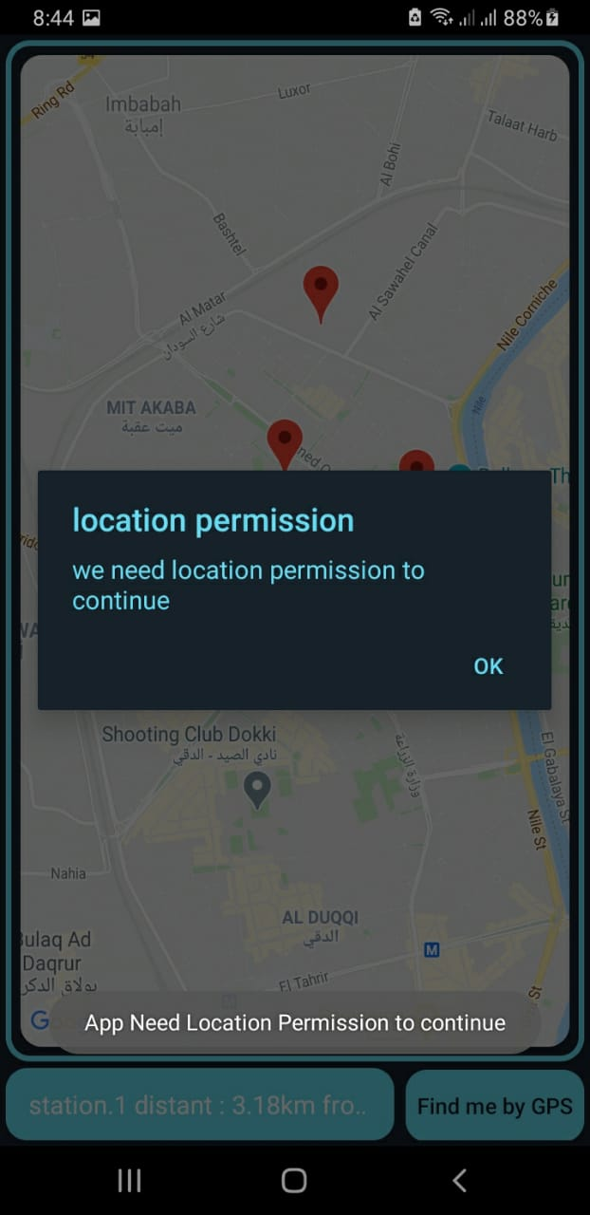
Setting new password and Home Screen

Slide 33
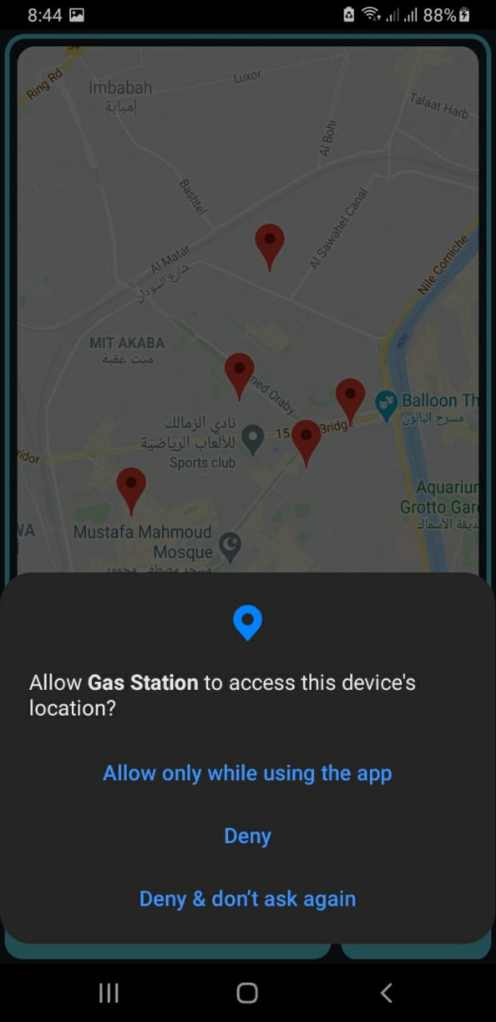
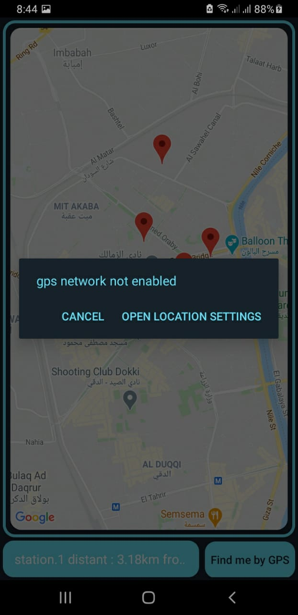
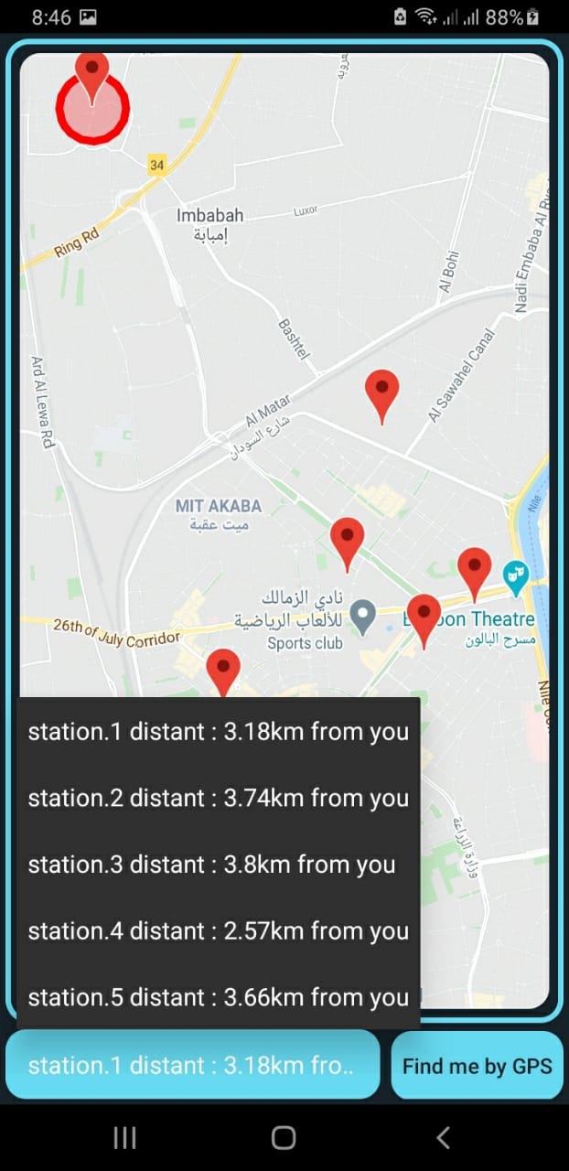
Request some permission and set Gas Station in order by distance

Slide 34
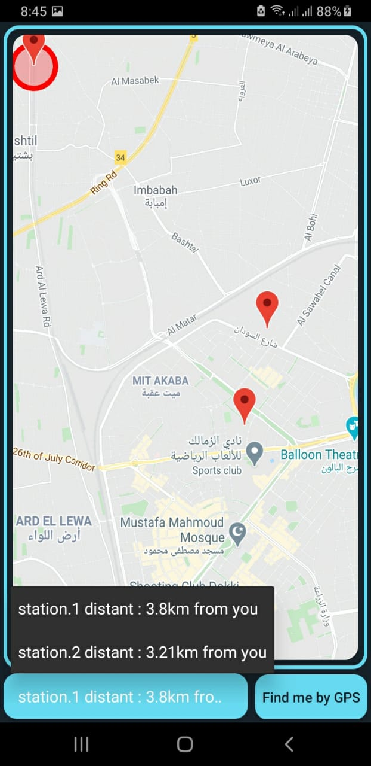
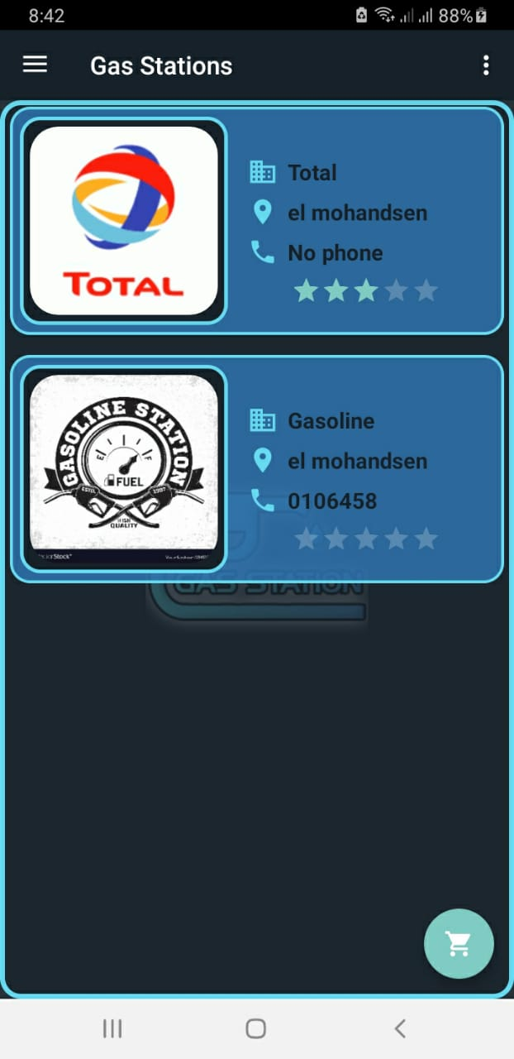
Set Gas Station in order by distance in Home page

Slide 35
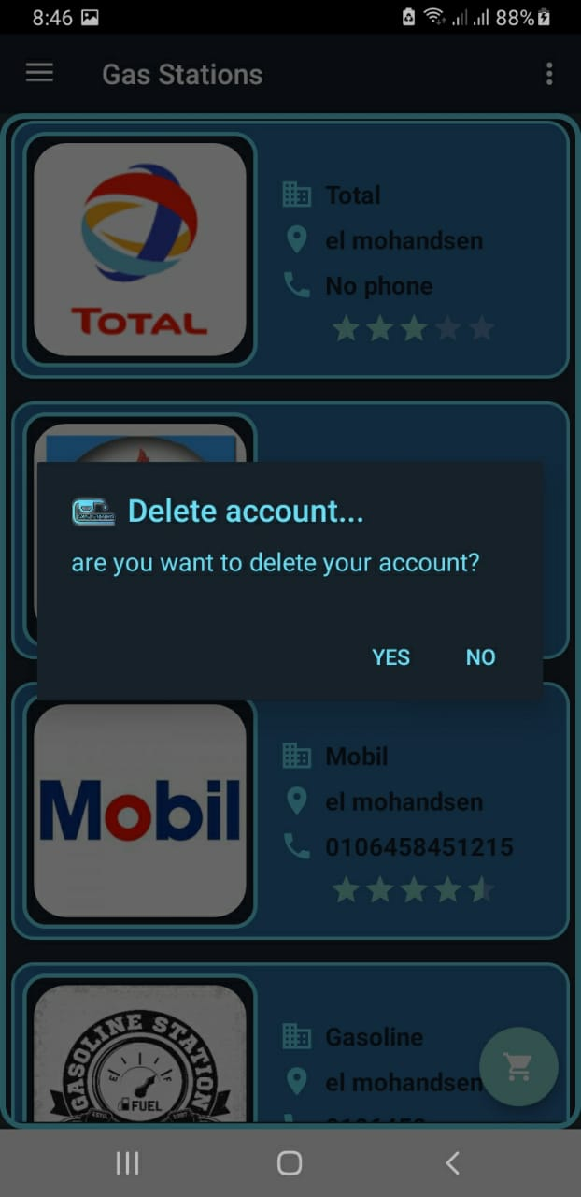
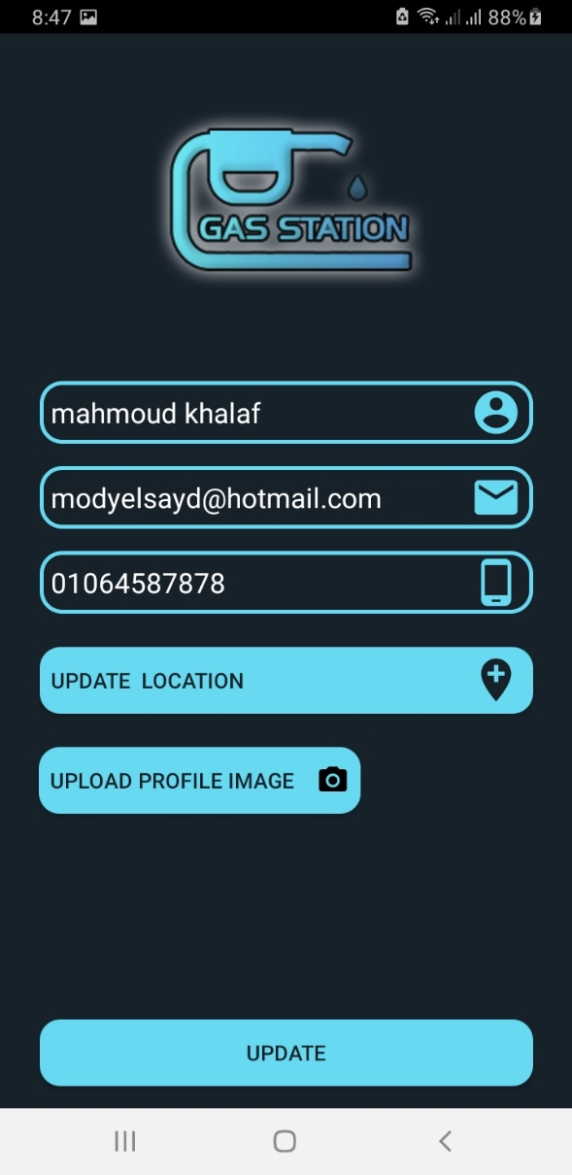
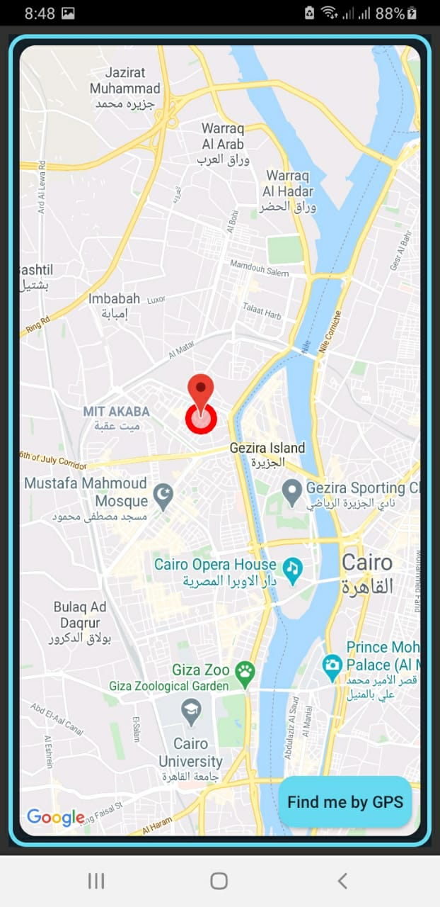
Deleting and edit user profile

Slide 36
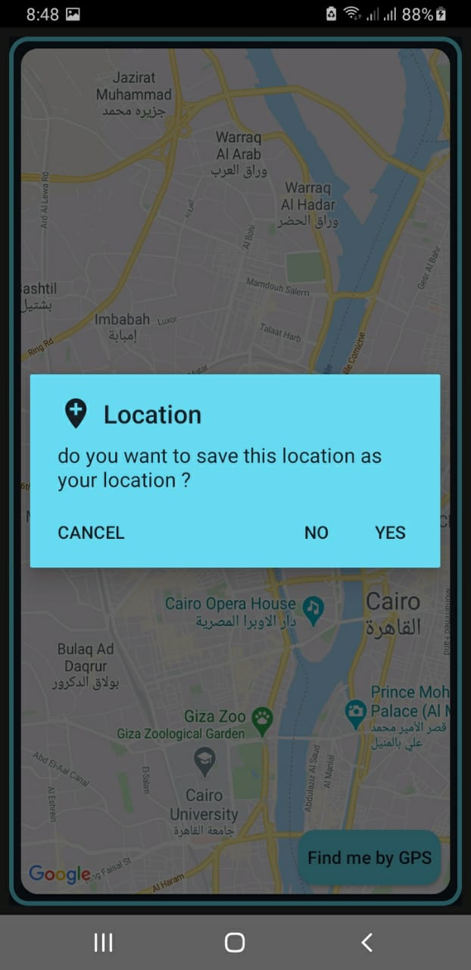
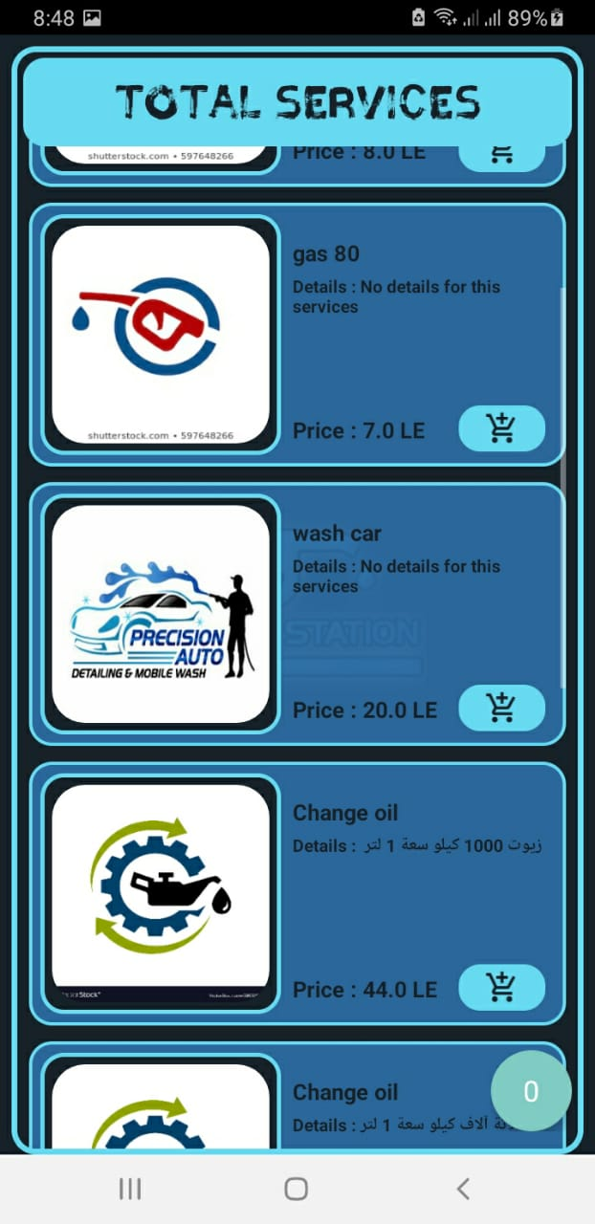
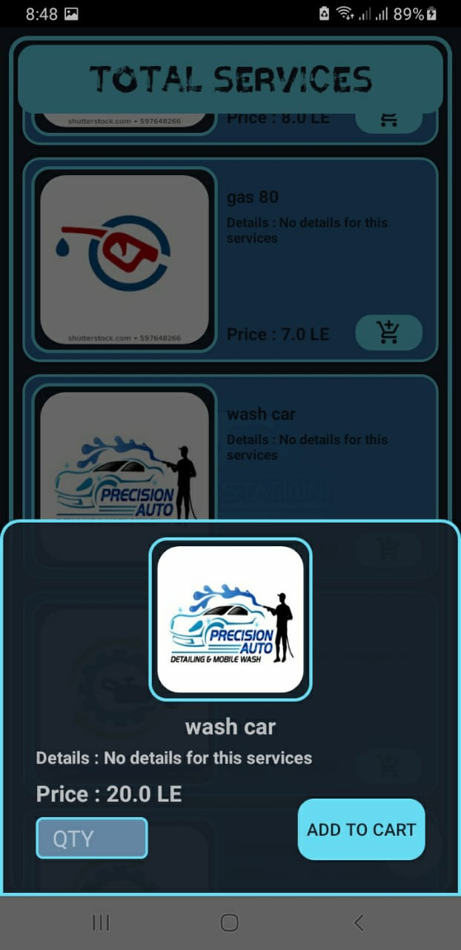
Save location and create order

Slide 37
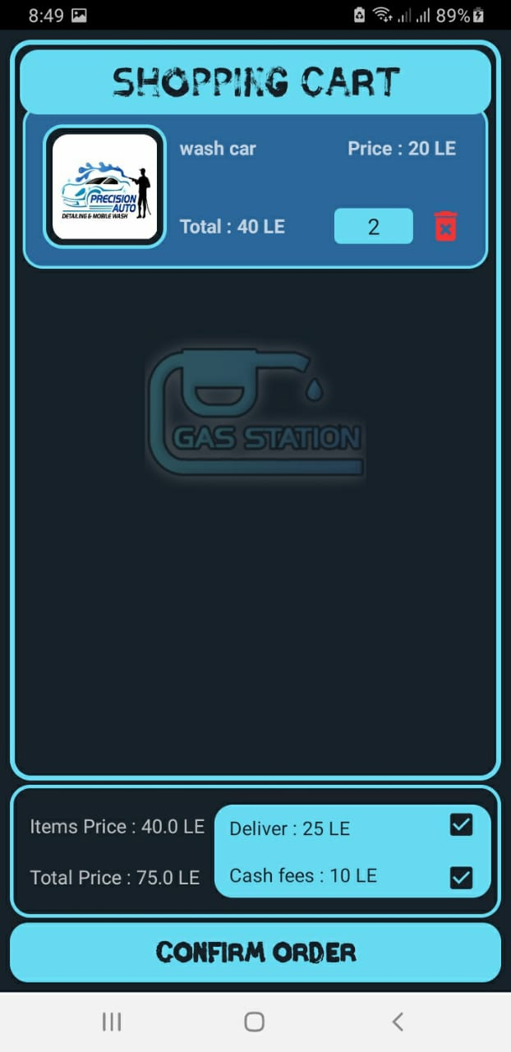
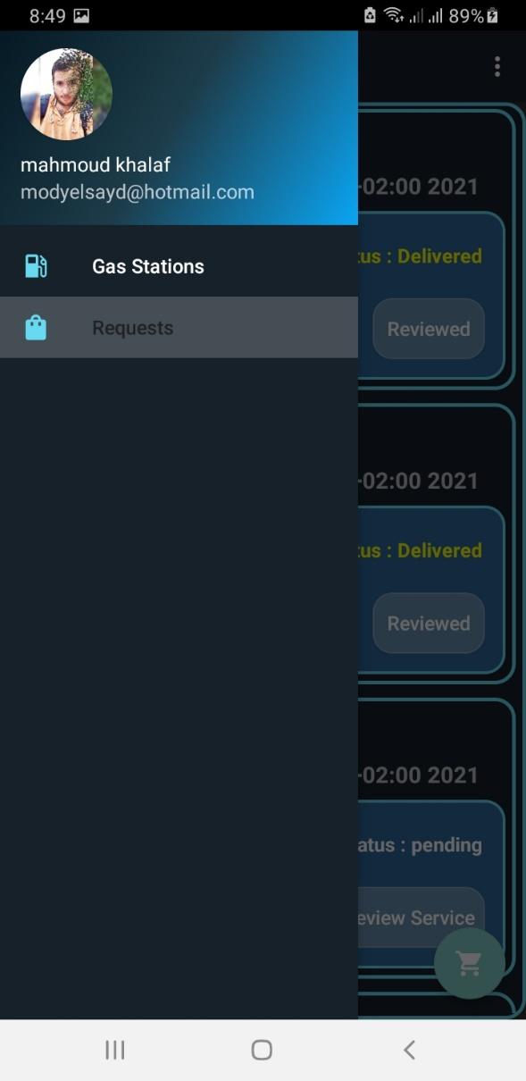
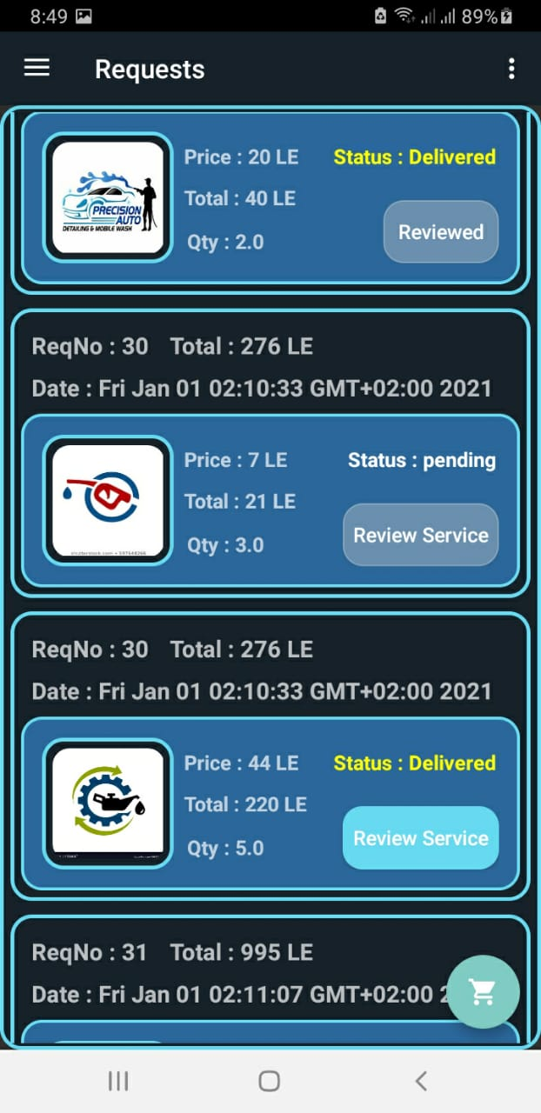
Confirm order and Requests page

Slide 38
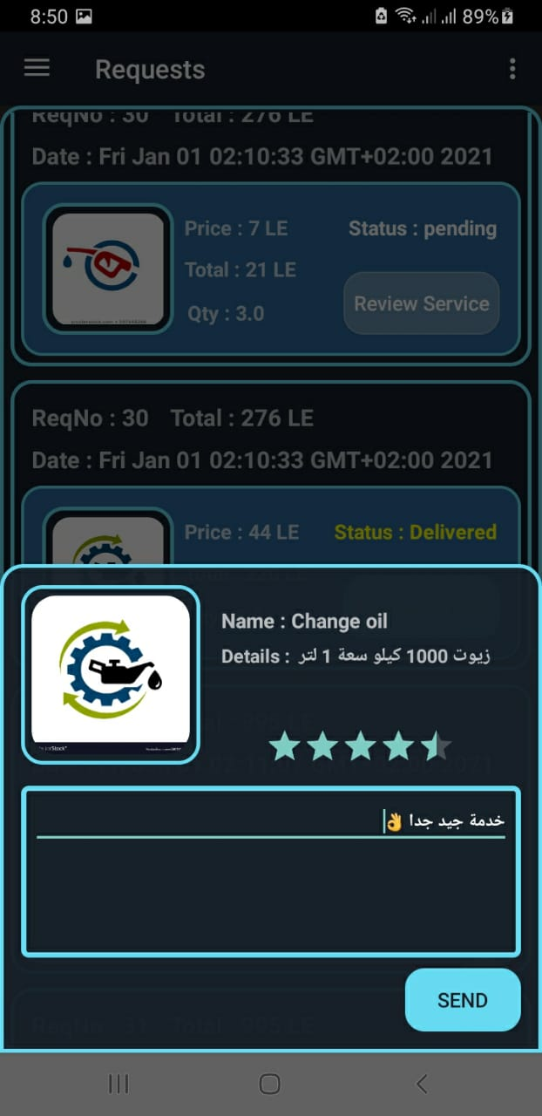
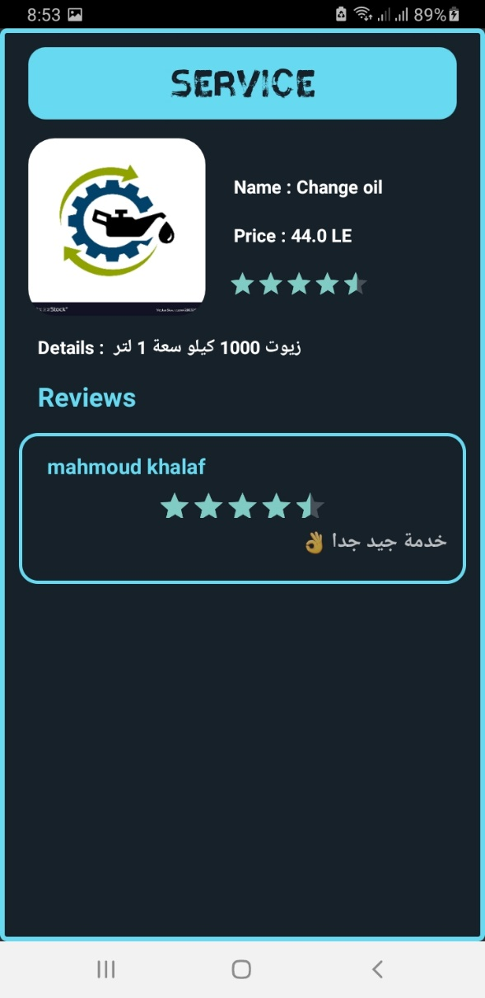
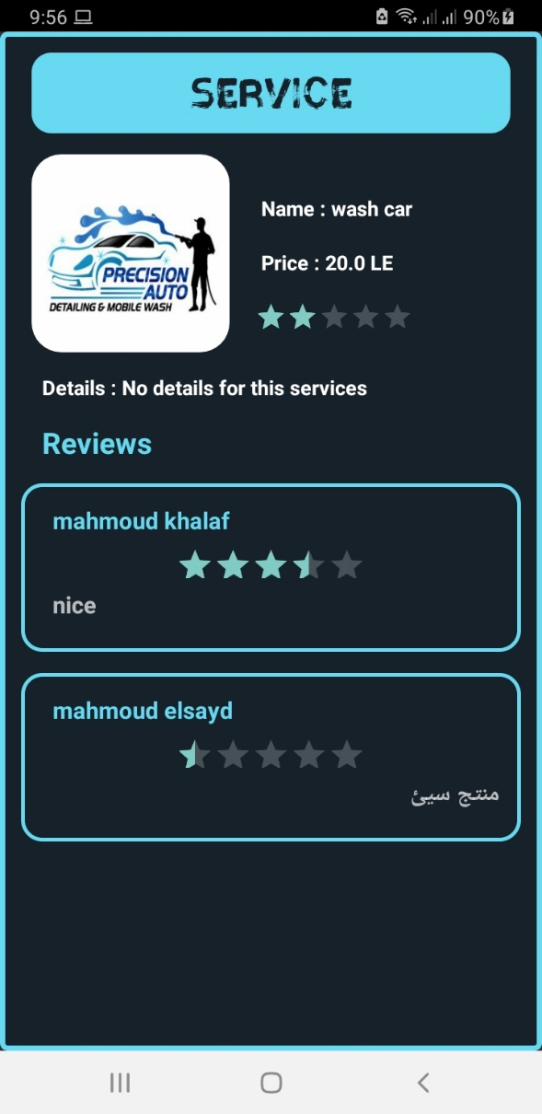
Review order and Service page

Slide 39
Future work
Add wishlist tap
Verification code by phone
Payment by visa and mastercard
Make an application for gas stations admin to add their services and manage their requests

Slide 40
Thank you

